Slide 1

SAP AI ACADEMY
Week 3: Generative AI Hub & Joule
Modern AI Development: Accessing LLMs, SDK Integration, and Prompt Engineering.

Slide 2


Week 3 Overview
Theory Focus
Practical Focus
We will explore the architecture of the SAP Generative AI Hub, focusing on the "Trust Layer" that secures enterprise data. We'll also cover the concepts behind RAG (Retrieval Augmented Generation) and Prompt Engineering strategies.
Hands-on labs will involve enabling entitlements in BTP, configuring the Python SDK, and building a context-aware chatbot using LangChain. You will deploy a working prototype by the end of the week.

Slide 3

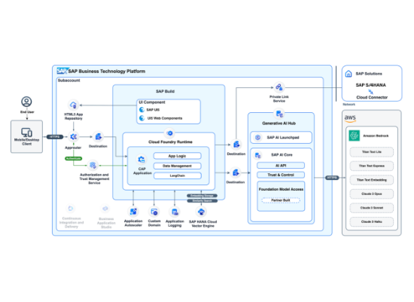
Day 11: Generative AI Hub Architecture
The Trust Layer
SAP does not host the LLMs directly but provides a secure proxy to providers like Azure OpenAI and AWS Bedrock. This ensures:
Data Privacy: Your data is not used to train foundation models.
Legal Compliance: Adherence to enterprise SLAs.
Abstraction: Switch models (e.g., GPT-4 to Claude) without rewriting code.

Slide 4






Day 11 Lab: Enabling Entitlements
1. BTP Cockpit
2. Add Service
3. Create Instance
Log in to your Trial Account and navigate to your Subaccount > Entitlements.
Search for "SAP AI Core" and "Generative AI Hub". Ensure you select the Free plan.
Go to Instances and Subscriptions and create a new instance for AI Core with the extended service plan.

Slide 5

Day 12: SAP GenAI SDK for Python
The generative-ai-hub-sdk is a Python wrapper designed to simplify interactions with the AI Hub.
Why use the SDK?
Token Management: Automatically handles OAuth tokens and connectivity.
Model Agnostic: Standardized API calls regardless of the underlying model (GPT-3.5, GPT-4, etc.).
Configuration: Easy management of deployments and resource groups via local config files.

Slide 6

Day 12 Lab: First API Call
Install the SDK via pip and run your first completion.
pip install generative-ai-hub-sdk
# Python Script
from gen_ai_hub.proxy.core.proxy_clients import get_proxy_client
proxy_client = get_proxy_client("gen-ai-hub")
response = proxy_client.chat.completions.create(
model_name="gpt-35-turbo",
messages=[{"role": "user", "content": "Hello SAP!"}]
)
print(response.choices[0].message.content)

Slide 7
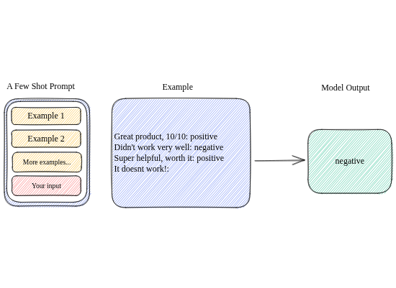
Day 13: Enterprise Prompt Engineering
Key Strategies
Prompting is the new coding. In an enterprise context, accuracy is paramount.
Zero-Shot: Asking the model without examples.
Few-Shot: Providing 2-3 examples (e.g., "Input: A, Output: B") to guide the model's format.
Chain-of-Thought: Asking the model to "think step-by-step" to improve reasoning on complex tasks.

Slide 8
Day 13 Lab: Business Prompting
TASK: SUMMARIZE PO
"You are a procurement assistant. Summarize the following Purchase Order for an executive review. Focus on the Total Value, Vendor Name, and any line items exceeding $1,000. Do not use technical jargon."
— Context-Aware System Prompt

Slide 9
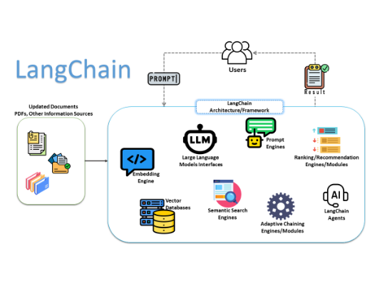
Day 14: LangChain Integration
Why LangChain?
While the SAP SDK handles the connection, LangChain handles the logic flow.
Chains: Sequence multiple LLM calls (e.g., Translate -> Summarize -> Email).
Memory: Allow the chatbot to remember previous questions in the conversation.
Agents: Let the LLM decide which tools to use (e.g., "Search DB" vs "Calculate").

Slide 10




Day 14 Lab: Building a Chatbot
1. Initialize LLM
2. Add Memory
Use LangChainOpenAI but point it to the SAP GenAI Hub proxy URL.
Implement ConversationBufferMemory to store the chat history.
3. Create Chain
4. Execute
Combine the LLM, Prompt Template, and Memory into a single execution chain.
Run the loop: chain.predict(input="My question...").

Slide 11
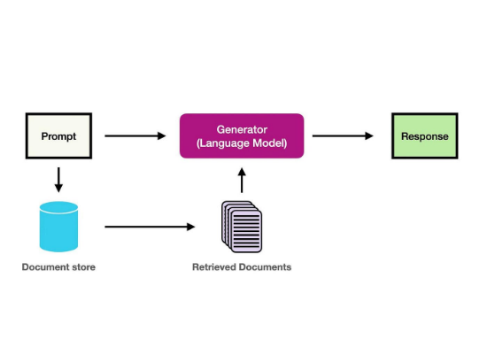
Day 15: RAG Concepts
Retrieval Augmented Generation
LLMs hallucinate. RAG grounds them in your trusted enterprise data.
Retrieval: Search a Vector Database (like SAP HANA Cloud) for relevant documents.
Augmentation: Inject these documents into the prompt context.
Generation: The LLM answers the user's question using only the provided facts.

Slide 12






Day 15 Lab: RAG Simulation
1. Ingest
2. Embed
3. Query
Load a local PDF or text file containing "proprietary" information.
Convert text to vectors using the text-embedding-ada-002 model via SDK.
Find the most similar text chunk to the user's question and pass it to GPT-4.

Slide 13


Week 3 Complete!
You have mastered the GenAI Hub, SDK, and RAG basics.
Next Up: Week 4 - Capstone Project & Production

Slide 14






Image Sources
https://d2908q01vomqb2.cloudfront.net/17ba0791499db908433b80f37c5fbc89b870084b/2024/05/31/AWS-for-SAP-Generative-AI-Hub-1260x582.png
Source: aws.amazon.com
https://eu-images.contentstack.com/v3/assets/blt6d90778a997de1cd/blt85f164bb7fd5392e/64f1746496efc94ac92f9003/python_Trismegist_san_shutterstock.jpg?width=1280&auto=webp&quality=80&disable=upscale
Source: www.darkreading.com
https://developers.sap.com/tutorials/cp-trial-entitlements/jcr:content.github-proxy.1700503212.file/FreeQuotaEntitlements.png
Source: developers.sap.com
https://learnprompting.org/docs/assets/basics/few_shot.svg
Source: learnprompting.org
https://miro.medium.com/1*TcKz4RNXI2QN3Ben0VTbag.png
Source: medium.com
https://miro.medium.com/v2/resize:fit:1400/1*MI9WDgzoOGAH4bOnAwBKEw.jpeg
Source: blog.gopenai.com

